Slide 1

HR analetics
​project

Slide 2

Agenda
Introduction
Problem
terminology
Data cleaning
Data exploration
Model bulding

Slide 3

Introduction
employee attrition is an Unpredictable and uncontrollable,
but normal, reduction of work force due to resignations, retirement, sickness, or death. However
there are some statistical procedures or techniques, through which employee attrition can be
predicted. This paper is an attempt to show how attrition can be predicted using logistic
regression thus can be controlled.

Slide 4
Problem
Attrition is a big problem in industries like IT, BPO and KPO etc. This problem can be attributed
to dissatisfaction to various aspects of a job, for example career aspirations, work location, salary, WORK LODE , IMPRUMENT
performance management, job satisfaction, managers and many more.
Employee attrition control is critical to the long term health and success of any organization.
Staffing costs are one of the largest expenses regularly charged to the budget of organizations.
With salaries, benefits, bonuses, training and other personnel costs, companies invest a great deal
of resources in their employees. To reduce the cost of attrition, organizations need to ensure that
employees’ aspirations are met. It is a known fact that retaining the best employees ensures
customer satisfaction, increased revenues and satisfied colleagues and staff.

Slide 5
TERMINOLOGY
Data Collection and Business Understanding: collecting and analyzing the data to grasp better
what should be the main goals of the study.
• Data Pre-processing: pre-process the data to suit them with the analysis method. The preprocessing
may involve cleaning up the data, transforming the data, or creating new variables
that may bring useful information for the analysis steps.
• Exploratory Data Analysis (EDA): this step create textual and visual summaries of the dataset
that highlight some characteristics of the data.
• Model Selection and Training
• Test and Evaluate the Model: evaluate the performance of the proposed models.
EMPLOYEE
DATA COLLECTION & BUSSINESS UNDERSTANDING
DATA PREPROSESING
EXPLORATORY DATA ANYLYSIS
MODEL SELECTION & TRANING
TEST & EVALUATE THE MODEL

Slide 6
The methodology adopted in this work relates to the TDSP framework, Team Data Science
Process the scientific data analysis process is an agile and iterative data science methodology
designed to offer predictive analysis solutions and efficient, intelligent applications.
The TDSP methodology is applied to look for the reasons of employee attrition and to build a
predictive model according to the following phases
Collect the employee dataset, which consists of current and past employee observations
Apply various data cleaning techniques to prepare the dataset
Start a descriptive analysis of data to detect the key factors and trends that contribute to attrition
Elaborate the dataset for the training and testing phase and try several classification algorithms to
process it
Based on the results collected with test data, compare many performance metrics of machine
learning models and select which model best fits and gives the most accurate results for the given
problem and release HR support software that implements the classification model.

Slide 7
Phases of the analysis process

Slide 8
Data Cleaning
Data preparation is one of the most important aspects of machine learning; it is usually complex
and often requires rather a lot of time. In fact, it has been calculated that on average this operation
requires 60% of the time and energy spent on a data science project [33]. Therefore, attention should be
paid to the preliminary stages of Business Understanding and Data Understanding, which will simplify
the next stages of the process. The first performed activity was the data selection: the data relevant to
the target was selected from the initial dataset; characteristics considered less significant or redundant
were removed, such as the progressive number of the employee (1, 2, 3, . . . ), flags marking over
18s (the “age” variable), hourly and weekly rates (monthly rates are also present). Then, “null” and
“undefined” values or duplicate records were identified, since they could inadvertently influence the

Slide 9
Data Exploration
At this point we generated the descriptive statistics of the dataset in order to observe the
characteristics of all variables. We considered the following variables: count, unique, top, frequency,
mean, standard deviation (std), minimum and maximum values (min/max), 25%/50%/75% percentile.
An extract of the overall dataset is reported in Figure 2.
FIGURE 2

Slide 10
Model Building
The modelling process consists in selecting models that are based on various machine learning
techniques used in the experimentation. In this case various predictive models were used such as
those based on decision tree, Bayesian method, logistic regression and SVM. The goal is to identify the
best classifier for the analysed problem. Each classifier must therefore be trained on the featured set
and the classifier with the best classification results is used for prediction. The classification algorithms
taken into consideration are:
• Gaussian Naive Bayes,
• Naive Bayes classifier for multivariate Bernoulli models,
• Logistic Regression classifier,
• K-nearest neighbours (K-NN),
• Decision tree classifier,
• Random forest classifier,
• Support Vector Machines (SVM) classification,
• Linear Support Vector Machines (LSVM) classification.

Slide 11
After identifying the objectives and adequately preparing and analysing the dataset to be used,
we proceeded with the design of the prediction model to identify employees that would potentially
leave the company. In the construction phase of a model that implements a supervised learning
algorithm, it was necessary to have a training-set available that consisted of instances of an already
classified population (target), in order to train the model to classify new observations, which will
constitute the test-set (in which the attribute representing the class was missing). Then, the model must
be trained on a consistent number of observations in order to refine its prediction ability. The precision
of the machine learning algorithms increases with the amount of data available during training. Ideally,
one would have two distinct datasets: one for training and a second to be used as a test. As two
dedicated datasets were not available in this case, the original dataset was divided into two parts with
a 70:30 ratio, one used for training and one used for testing (see Figure 12):

Slide 12
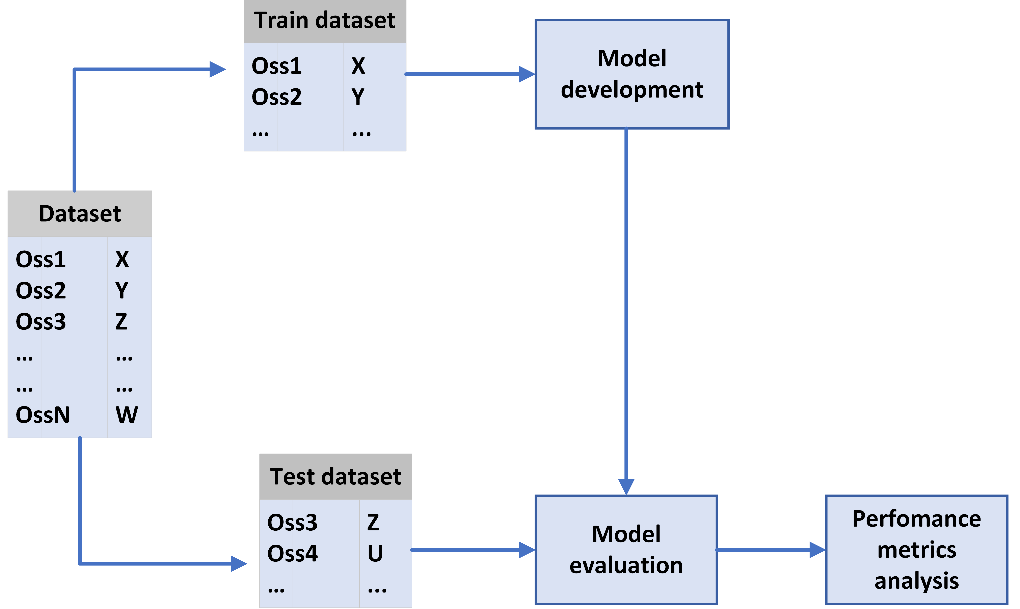
Train set contained 70% of the dataset. This information was dedicated to the training phase
in order to allow the model to learn the relationships hidden in the data; the train-set contains
1029 observations;
• Test set contained the remaining 30%. This information was dedicated to the test and validation
phase in order to evaluate the general performance of the model and to calculate errors between
predicted and actual results; the test-set contains 441 observations.
In addition, the newly created train and test datasets were further divided to extract the target
variable (“Attrition”); the label was stored in a dedicated dataset (y) separating it from the dataset (X)
containing the rest of the variables:
• X, containing all independent variables;
• y, containing the dependent variable, i.e., “Attrition”;
When evaluating the performance of a model, it is important to perform independent evaluation
tests and to use multiple observations in assessment in order to obtain more reliable and accurate
indicators of errors. Therefore, we adopted the following two techniques for a better error estimation:

Slide 13
Quarterly performance

Slide 14
Areas of growth
2022 | B2B | Supply chain | ROI | E-commerce
Q1 | 4.5 | 2.3 | 1.7 | 5.0
Q2 | 3.2 | 5.1 | 4.4 | 3.0
Q3 | 2.1 | 1.7 | 2.5 | 2.8
Q4 | 4.5 | 2.2 | 1.7 | 7.0

Slide 15

“Business opportunities are like buses.
There’s always another one coming.”
Richard Branson

Slide 16

Plan for product launch
planning
marketing
design
strategy
Launch
Synergize scalable
e-commerce
Disseminate standardized metrics
Coordinate
e-business applications
Foster holistically superior methodologies
Deploy strategic networks with compelling
e-business needs

Slide 17

Timeline
Sep
oct
nov
dec
jan
Synergize scalable
e-commerce
Disseminate standardized
metrics
Coordinate
e-business applications
Foster holistically superior methodologies
Deploy strategic networks with compelling
e-business needs

Slide 18


Thank you

